Slide 1

Data Visualisation
Group 3
Patrick Pilipiec
Yuyu Shu
John Strachan
Jenny Tran
University of Edinburgh
Thursday 20th February 2020.

Slide 2
CONTENTS
Brief Formulation: slides 3 to 8
Data Acquisition: slides 9 to 13
Chart Selection: slides 14 to 26
Implementation: slides 27 to 41

Slide 3

BRIEF FORMULATION
Group 3: Yuyu Shu

Slide 4
Content
Introduction
Background
Motivation

Slide 5
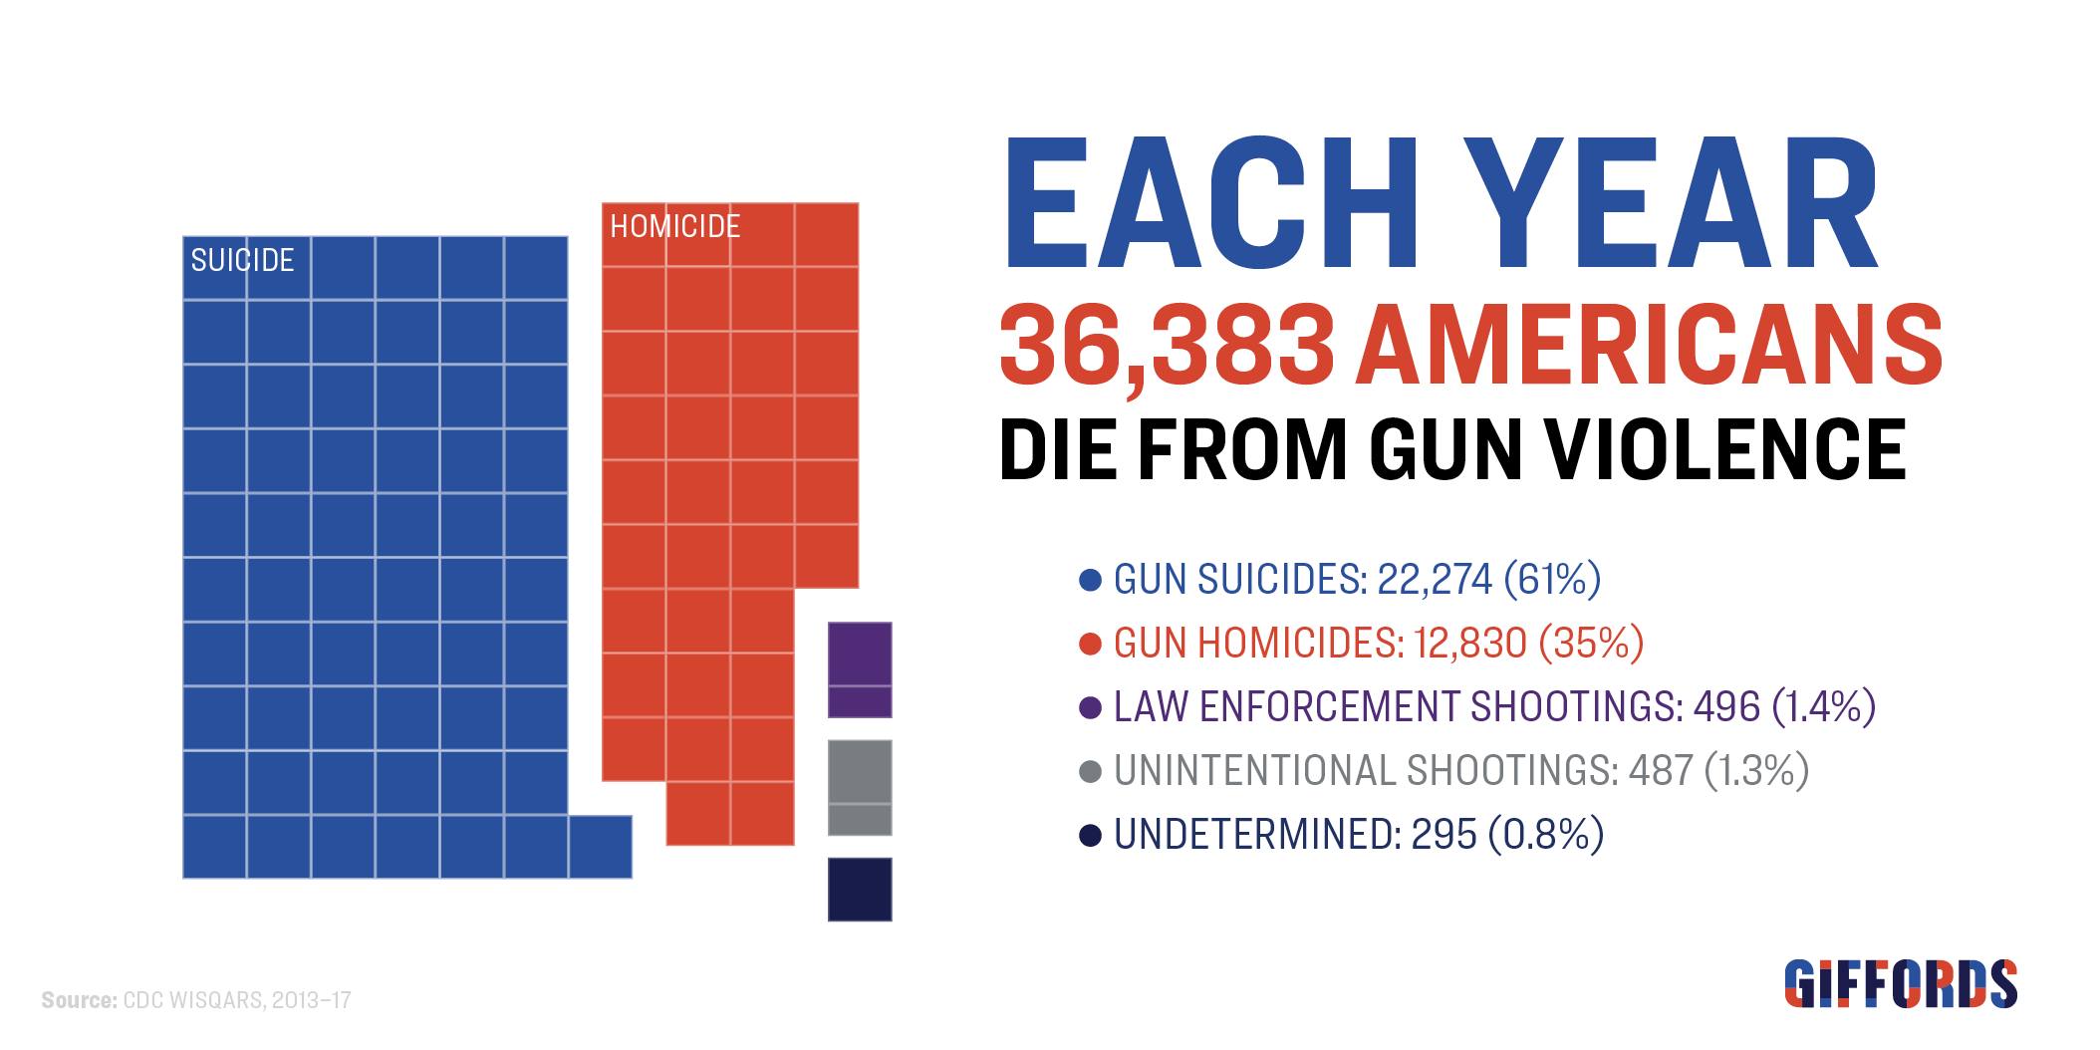
INTRODUCTION
rates of gun ownership
rates of gun-related violence
America vs. Switzerland(and other highest gun ownership countries)
the realationship between gun ownership and gun-related violence

Slide 6
background
Centers for Disease Control and Prevention
nearly 40,000 Americans who died of gun-related injuries in 2017 marked a 19% increase from 2012 and the highest annual total since the mid-1990s.
the US gun homicide rate is 25 times that of other high-income countries.
GIFORDS
guns are used in 51% of suicide deaths in America.
the unintentional gun deaths comprise 1.3% of gun deaths and 18% of gun injuries.
Pew Research Center
nearly half of adults (47%) say there would be fewer mass shootings if it was harder for people to obtain guns legally. 46% says there would be no difference.
6% say there would be more mass shootings if it was harder for people to obtain guns legally.
Americans' common consideration
resources:
https://lawcenter.giffords.org/wp-content/uploads/2019/05/Giffords-Law-Center-Facts-about-Gun-Violence.pdf
https://www.people-press.org/2018/10/18/gun-policy-remains-divisive-but-several-proposals-still-draw-bipartisan-support/#impact-of-changes-in-access-to-guns-on-crime-mass-shootings

Slide 7
motivation
Audience' concern: the influence on the gun deaths of gun policy
Visualisation:
The comparison of homicides, total gun deaths and firearms ownership between America and Switzerland
The comparison of total gun death and firearms ownership among top countries with highest gun ownership
Main purpose
Explore the relationship between the guns ownership and the homicides/total gun death
Developing own ideas

Slide 8

CONCLUSION
Project Function:
Exploratory tone
Whether the gun ownership is related to the gun-related violence

Slide 9
Data Acquisition
Group 3: Jenny Tran

Slide 10
Content
Acquiring the data
Cleaning the data
Fitting the purpose
Familiarising with the data
Discovering the key insights of the data

Slide 11
Acquiring the data
Finding the right data
Trustfully data
Data which is available
Organisational data provider like government or foundation
Challenges:
Try to find full datasets
Check for different official websites and goverment webpages or research fundation websites

Slide 12

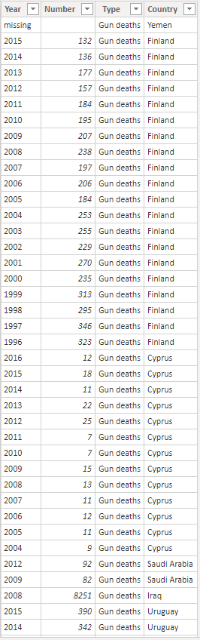
Cleaning the Data
Different formats
Incomplete datasets
Delete the data or take the average (only those years with full data)
Extract the years, gun deaths, homicides, countries etc.
Challenges:
Dealing with incomplete data
Some countries have more data and some only one dataset
Grouping the available data by countries and get the average value

Slide 13

ConClusion
Iterative process
Need a lot of communication and agreement between the group members

Slide 14
Chart selection
Group 3: Patrick Pilipiec

Slide 15
Content
Questions for visualisation
Chart selection
Conclusion

Slide 16
Questions for VisualisationDDes
Questions:
Eight questions were formulated that will be answered in this visualisation project.
See next slides for these questions.
Each question is visualised separately. Therefore, eight charts will be created.
Charts:
This project only uses the bar chart, clustered bar chart, and scatterplot to visualise the data. These chart types are very well-known by the public and do not require extensive knowledge and skills to be correctly interpreted.

Slide 17
Chart selection: chart 1Quest
Question
Visualisation
How do the USA and Switzerland compare regarding the average number of homicides per 100,000 persons from 1970-2017?
Title: Average of Homicides per 100000 people from 1970-2017
Horizontal bar chart
X-axis: Average of Homicides per 100000 people
Y-axis: Country (USA, Switzerland)
Columns are grouped by country
Data labels with value per group

Slide 18
Chart selection: chart 2Quest
Question
Visualisation
How do the USA and Switzerland compare regarding the average number of gun-related deaths per 100,000 persons from 1970-2017?
Title: Average of Gun deaths per 100000 people from 1970-2017
Horizontal bar chart
X-axis: Average of Gun deaths per 100000 people
Y-axis: Country (USA, Switzerland)
Columns are grouped by country
Data labels with value per group

Slide 19
Chart selection: chart 3Quest
Question
Visualisation
How do the USA and Switzerland compare regarding the maximum number of gun-related deaths per 100,000 persons from 1970-2017?
Title: Max of Gun deaths per 100000 people from 1970-2017
Horizontal bar chart
X-axis: Max of Gun deaths per 100000 people, Switzerland is presented as proportion of USA
Y-axis: Country (USA, Switzerland)
Columns are grouped by country
Data labels with value per group

Slide 20
Chart selection: chart 4Quest
Question
Visualisation
How do the USA and Switzerland compare regarding the minimum number of gun-related deaths per 100,000 persons from 1970-2017?
Title: Min of Gun deaths per 100000 people from 1970-2017
Horizontal bar chart
X-axis: Min of Gun deaths per 100000 people, Switzerland is presented as proportion of USA
Y-axis: Country (USA, Switzerland)
Columns are grouped by country
Data labels with value per group

Slide 21
Chart selection: chart 5Quest
Question
Visualisation
What is the relation between the number of firearms and the number of homicides per 100,000 persons, for the USA and Switzerland?
Title: Relation between Homicides and Firearms
Scatterplot
X-axis: Homicides per 100000 people
Y-axis: Firearms of population
Points are grouped by country

Slide 22
Chart selection: chart 6Quest
Question
Visualisation
How do the USA and Switzerland compare regarding the average number of gun deaths per 100,000 persons and the average homicides per 100,000 persons?
Title: Comparison gun deaths with homicides
Horizontal clustered bar chart
X-axis: Average of Gun deaths per 100000 people and Average of Homicides per 100000 people (clustered)
Y-axis: Country (USA, Switzerland)
Columns are grouped by country

Slide 23
Chart selection: chart 7Quest
Question
Visualisation
How does the USA compare to other countries regarding the average number of firearms per 100 persons from 1970-2017?
Title: Average of firearms per 100 people by country from 1970-2017
Vertical bar chart
X-axis: Country (USA and others)
Y-axis: Average of firearms per 100 people

Slide 24
Chart selection: chart 8Quest
Question
Visualisation
How does the USA compare to other countries regarding the average number of gun deaths per 100,000 persons from 1970-2017?
Title: Average of gun death per 100,000 people by country from 1970-2017
Vertical bar chart
X-axis: Country (USA and others)
Y-axis: Average of gun death per 100k people

Slide 25
Contribution as project managerDes
The project manager has contributed to this project as follows:
Stimulate communication and reflection between team members.
This project was broken down into many tasks that were distributed across group members. The progress of these tasks and their coherence and consistency had to be coordinated and aligned to result in this presentation.
Division of labour involves multiple work schedules of multiple members. The project manager ensures that all work is done correctly and on time.
Critically reflect on performed tasks and to improve work where possible.
Quality assessment to ascertain that the product meets the defined requirements.

Slide 26
CONCLUSION
Eight research questions
Eight charts: bar chart, clustered bar chart & scatterplot

Slide 27
Implementation
Group 3: John Strachan

Slide 28
Contents
Technologist
Repositories
Visualisations
Further developments

Slide 29
TECHNOLOGIST
Supportive
Investigative
Constructive

Slide 30

Repositories
https://github.com/data-visualisation-group-three/raw-data
https://github.com/data-visualisation-group-three/cleaned-data
https://github.com/data-visualisation-group-three/visualisations

Slide 31
VISUALISATIONS
Questions 1 to 8

Slide 32
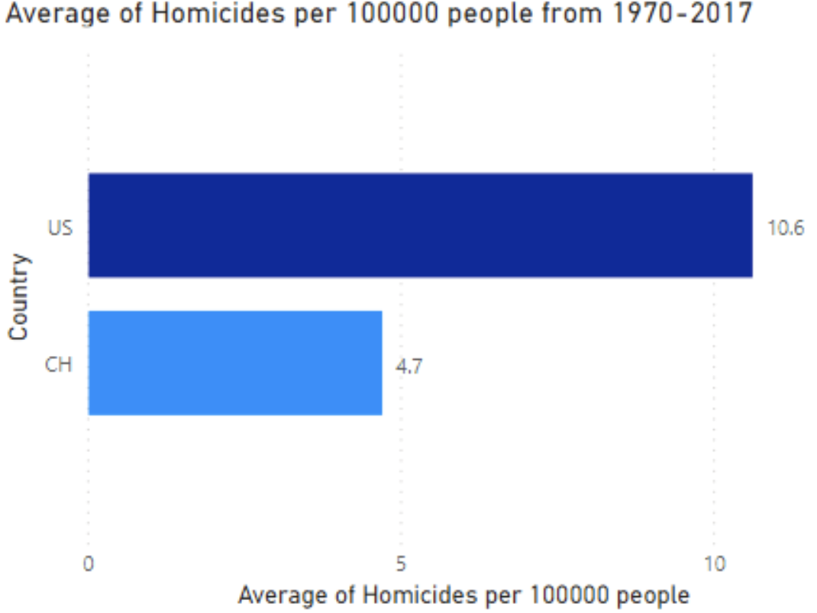
Question 1
How do the USA and Switzerland compare regarding the average number of homicides per 100,000 persons from 1970-2017?

Slide 33
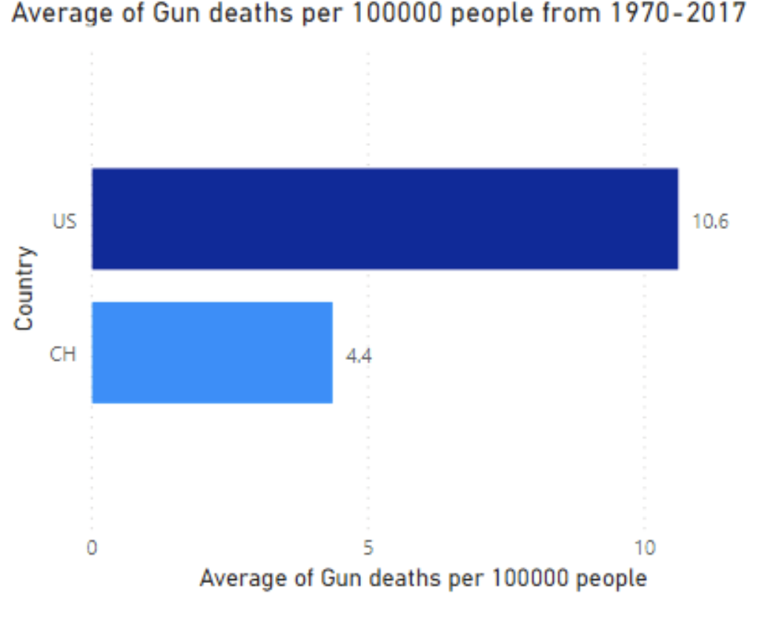
Question 2
How do the USA and Switzerland compare regarding the average number of gun-related deaths per 100,000 persons from 1970-2017?

Slide 34
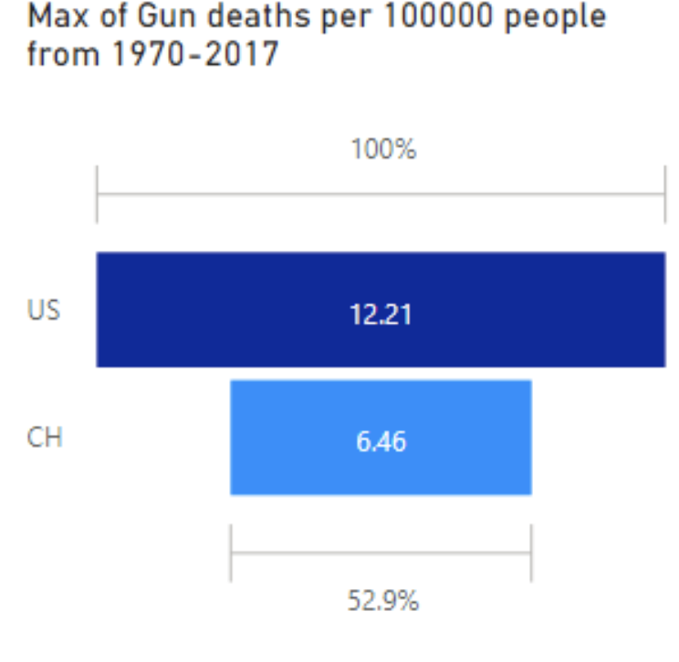
Question 3
How do the USA and Switzerland compare regarding the maximum number of gun-related deaths per 100,000 persons from 1970-2017?

Slide 35
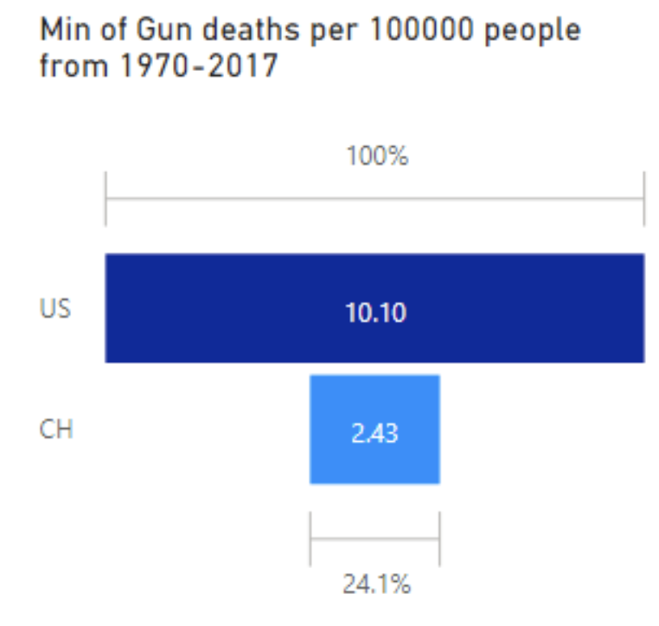
Question 4
How do the USA and Switzerland compare regarding the minimum number of gun-related deaths per 100,000 persons from 1970-2017?

Slide 36
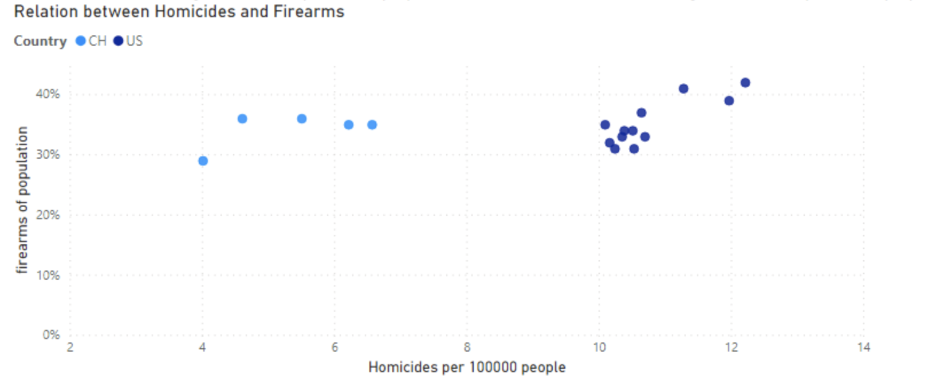
Question 5
What is the relation between the percentage of firearms and the number of homicides per 100,000 persons, for the USA and Switzerland?

Slide 37
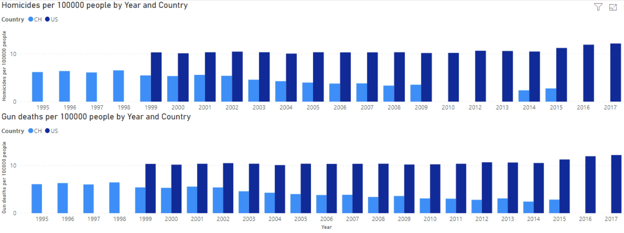
Question 6
How do the USA and Switzerland compare regarding the average number of gun deaths per 100 persons and the average homicides per 100,000 persons?

Slide 38
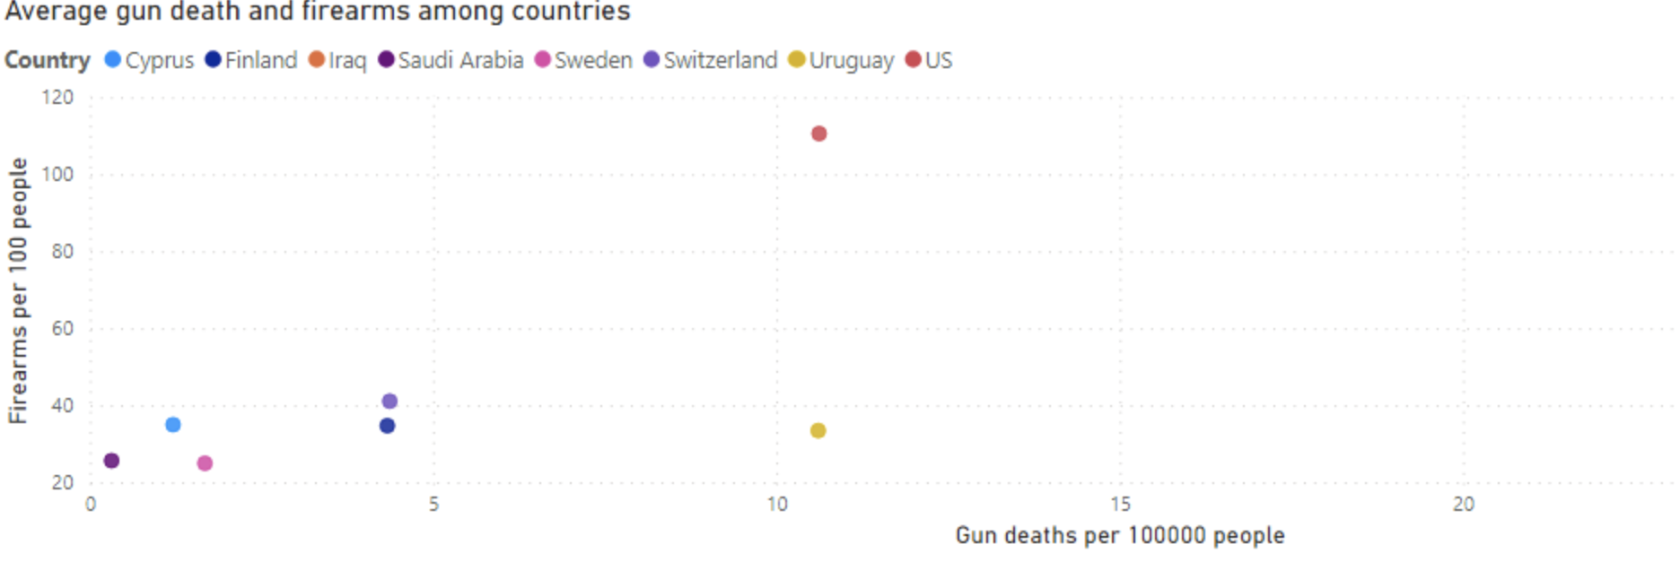
Question 7
How does the USA compare to other countries regarding the average number of firearms per 100 persons from 1970-2017?

Slide 39
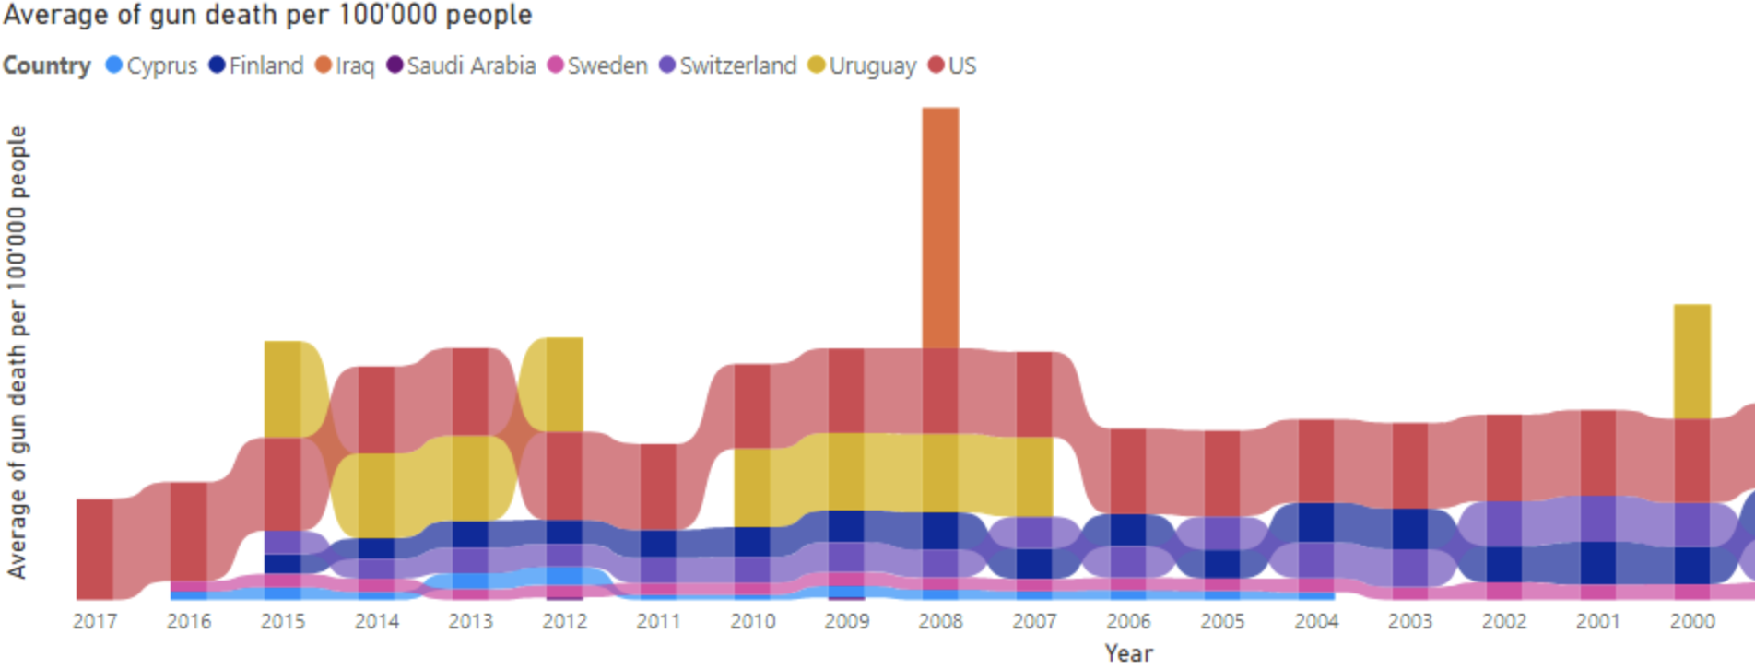
Question 8
How does the USA compare to other countries regarding the average number of gun deaths per 100,000 persons from 1970-2017? https://theglobalamericans.org/2018/05/why-have-violent-crime-and-murder-spiked-in-uruguay/

Slide 40
FURTHER DEVELOPMENTS
What medium would best suit the tone (exploratory) and questions in terms of reaching the greatest audience and having the most impact?

Slide 41
Conclusion
The visualisations clearly depict the differing rates of homicide and gun deaths relative to the percentages of firearms in the population between the United States of America and Switzerland, and, thereby, invites the viewer to question the underlying causes of those differences.

Slide 42
Thank you for taking the time to review this presentation by Group Three for the Data Visualisation course at the University of Edinburgh.

